Slide 1
B: Overview of Models
Brian Joyce, SEI
Denis Hughes, Rhodes University
Mark Howells, KTH

Slide 2
Outline
Brian and Denis describe:
  WEAP model of Orange-Senqu
  How WEAP model is consistent with other modeling in the region
  Initial results showing climate change impacts
Mark describes:
  SAPP model of South African power pool
  How SAPP model is consistent with other modeling in the region
  Initial results showing climate change impacts

Slide 3
Water Modeling

Slide 4
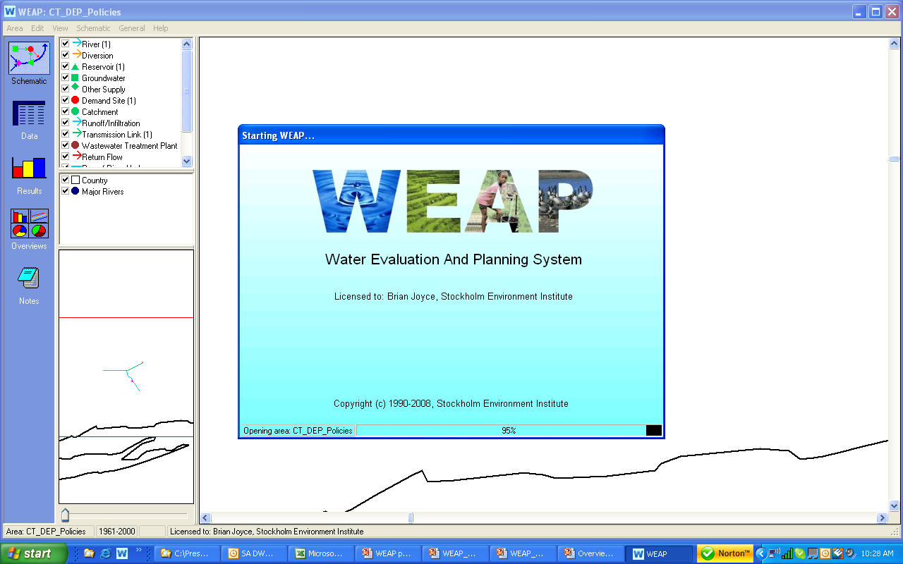
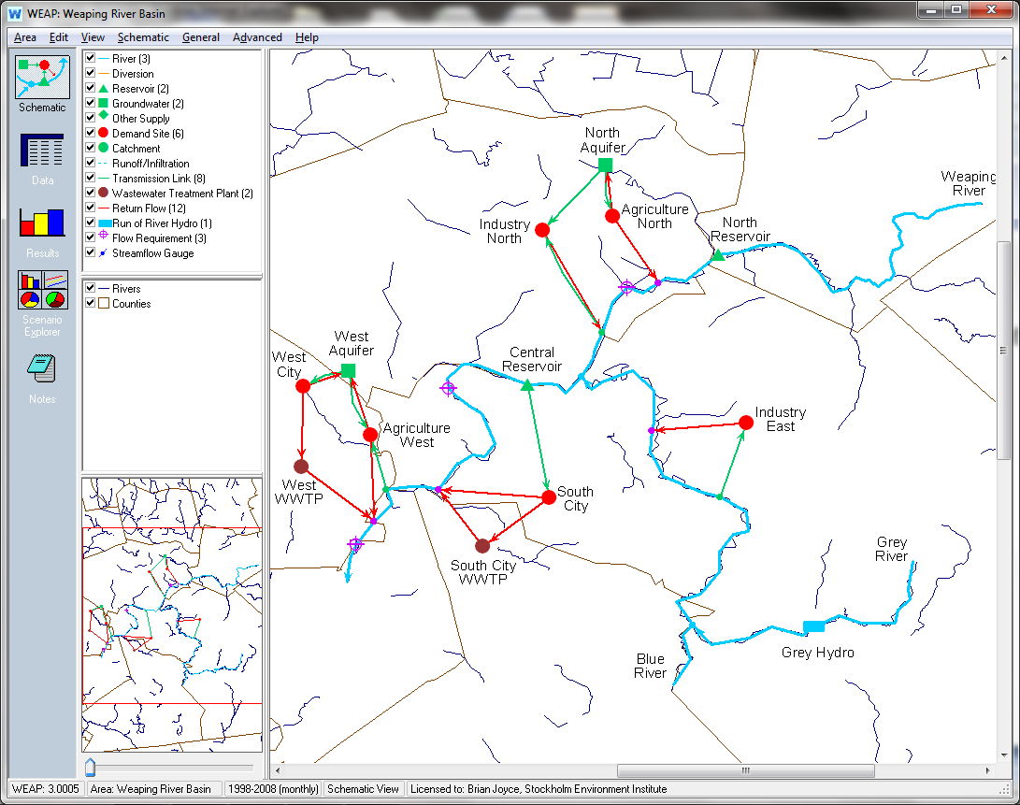
The Water Evaluation and Planning (WEAP) System
Generic, object-oriented, programmable, integrated water resources management modeling platform

Slide 5
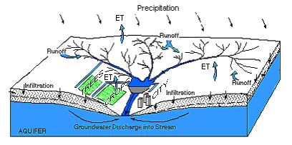
In developing WEAP, SEI is seeking to create a truly integrated water modeling platform

Slide 6
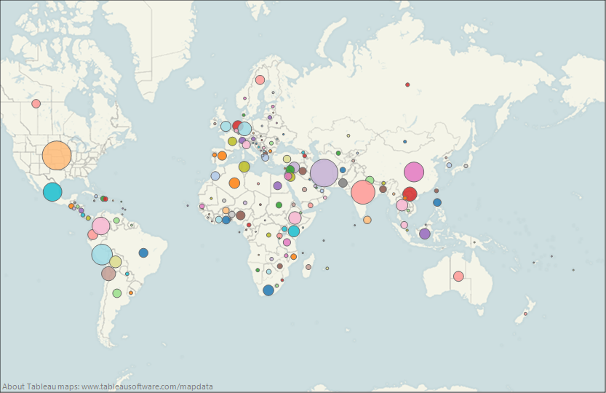
WEAP is a globally renowned water modeling platform
As of July 2nd 2013
Top 10 Forum Members by Country
171 Countries | 11602 Members
USA | 1090
Iran | 982
India | 733
Peru | 561
China | 505
Mexico | 473
Colombia | 435
Chile | 261
Vietnam | 258
Germany | 243
WEAP Downloads:
In last day: | 14
In last week: | 46
In last month: | 364
In last 12 months: | 3321

Slide 7
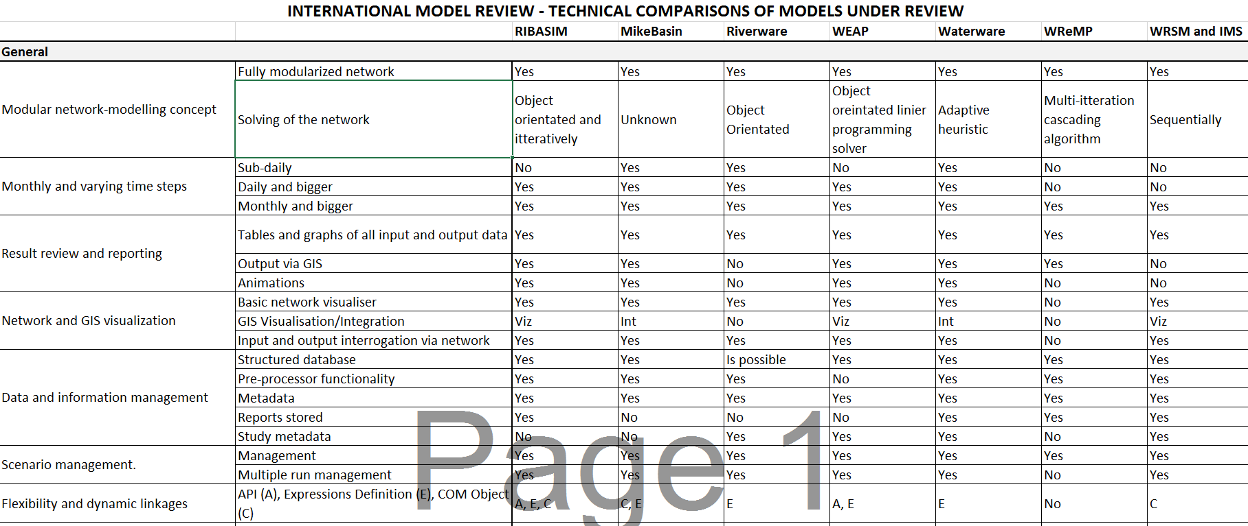
The DWAF evaluation of WEAP

Slide 8
Conclusions from DWAF Evaluation
WEAP water use estimates similar to WRSM
“Even though most of the international models would be able to mimic these water use estimates through their interoperability, the evaluation shows that WEAP and RIBASIM seems to have the most explicitly defined comparative water use definitions to WRSM.”
Integration of WEAP hydrology seen as benefit
“It was found that all the models have similar hydrological and system feature capabilities. MikeBasins, WEAP and Ribasim, however, had strong interoperability capabilities to make provision for any shortcomings in the WRSM capabilities.”
WEAP water quality routine has regional importance
“WEAP links directly to Qual2K which is currently seen as one of the important eutrophication models and is currently used to assess operational planning in one of the main rivers in South Africa”

Slide 9
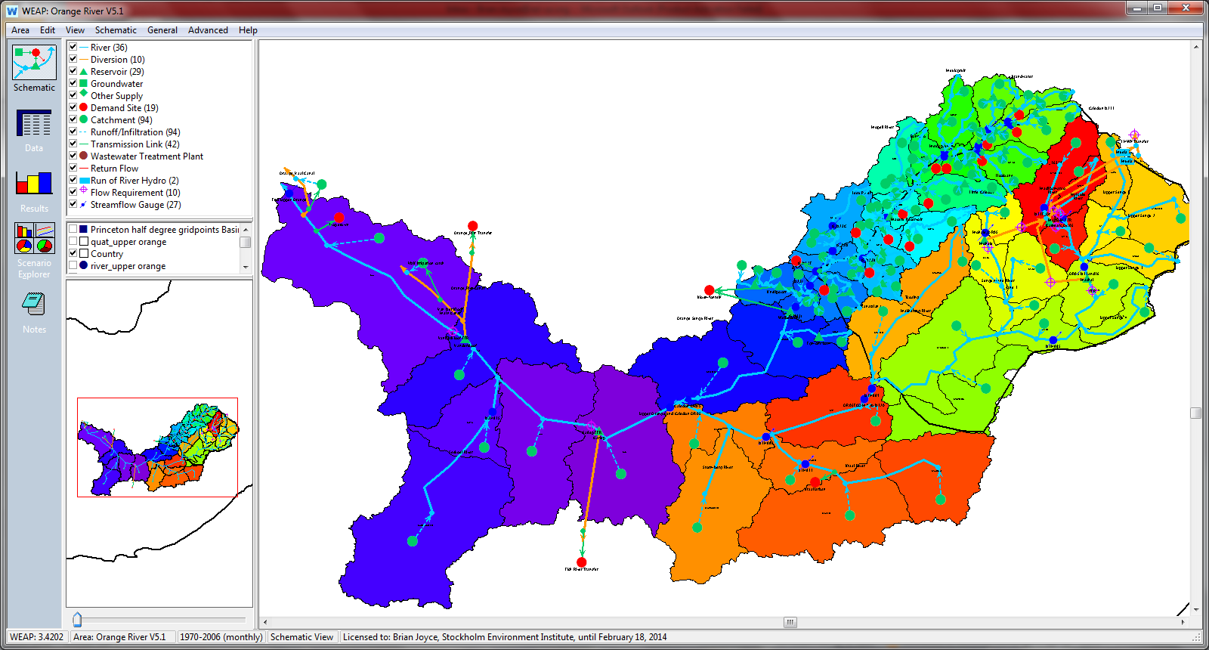

WEAP Model of Upper Orange-Senqu River

Slide 10
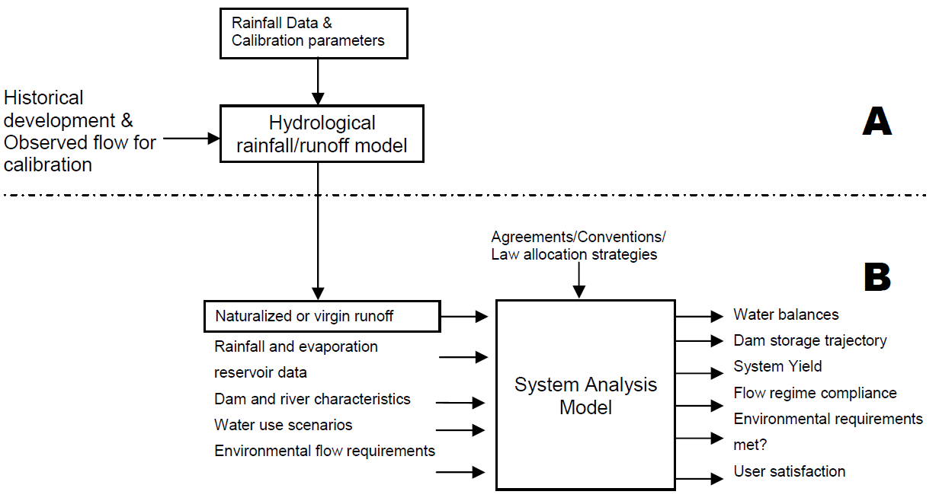
Two-Step Process for Developing a WEAP Model
from Juizo & Liden, Hydrologic Earth System Sciences (2010)

Slide 11
Subcatchment
River Flow
Border
Flow Records
Simplified Schematic of Upper Orange-Senqu River System
Brandwater
Muelspruit
Mopeli
(Pre-Development)
Leeu
Lisoloane
Little Caledon
Tsoaing
Tsanatalana
Senqunyane
Madibamatso
Caledon River
Makhaleng
Matsoku
Upper Orange River
Senqu River
Stormberg
Seekoei
Kraai

Slide 12
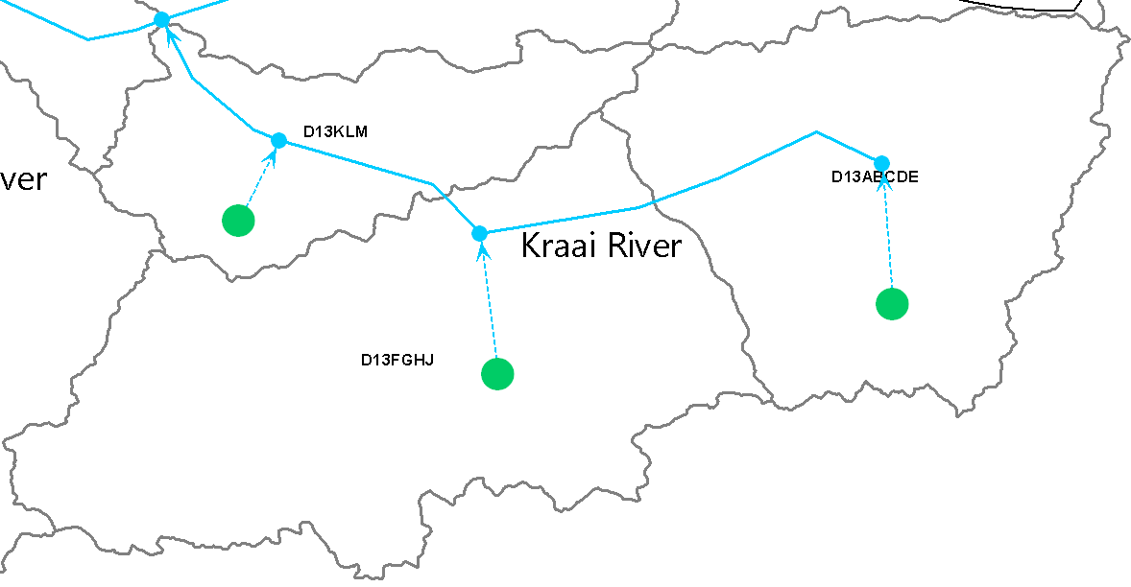
WEAP’s Soil Moisture Hydrology Model
Hydrology module covers the entire extent of the river basin
Study area configured as a contiguous set of catchments
Lumped-parameter approach calculates water balance for each catchment
Example: Kraai River Catchments
Notes:
The hydrology module in WEAP is spatially continuous, with a study area configured as a contiguous set of catchments that cover the entire extent of the represented river basin. This continuous representation of the river basin is overlaid with a water management network topology of rivers, canals, reservoirs, demand centers, aquifers, and other features (Yates et al., 2005a and 2005b). Each catchment is fractionally subdivided into a unique set of independent land-use or land-cover classes that lack detail regarding their exact location within the catchment, but which sum to 100 percent of the catchment’s area. A unique climate data set of precipitation, temperature, relative humidity, and wind speed is uniformly prescribed across each catchment.
A one-dimensional, quasi-physical water balance model depicts the hydrologic response of each fractional area within a catchment and partitions water into surface runoff, infiltration, evapotranspiration (ET), interflow, percolation, and baseflow components. Values from each fractional area (fa) within the catchment are then summed to represent the lumped hydrologic response for all land cover classes, with surface runoff, interflow, and baseflow being linked to a river element; deep percolation being linked to a groundwater element where prescribed; and ET being lost from the system.
The hydrologic response of each catchment is depicted by a “two-bucket” water balance model as shown in Figure 3-3. The model tracks soil water storage, in the upper bucket, z_{fa}, and in the lower bucket, Z. Effective precipitation, Pe, and applied water, AW, are partitioned into evapotranspiration (ET), surface runoff/return flow, interflow, percolation and baseflow. Effective precipitation is the combination of direct precipitation (P_{obs}) and snowmelt (which is controlled by the temperatures at which snow freezes, T_{s}, and melts, T_{l}). Soil water storage in the shallow soil profile (or upper bucket) is tracked within each fractional area, fa, and is influenced by the following parameters: a plant/crop coefficient (kc_{fa}); a conceptual runoff resistance factor (RRF_{fa}); water holding capacity (WC_{fa}); hydraulic conductivity (HC_{fa}); upper and lower soil water irrigation thresholds (U_{fa} and L_{fa}); and a partitioning fraction, f, which determines whether water moves horizontally or vertically. Percolation from each of these fractional areas contributes to soil water storage (Z) in the deep soil zone (or lower bucket) and is influenced by the following parameters: water holding capacity (WC_{fa}), hydraulic conductivity (HC_{fa}), and the partitioning fraction, f.

Slide 13
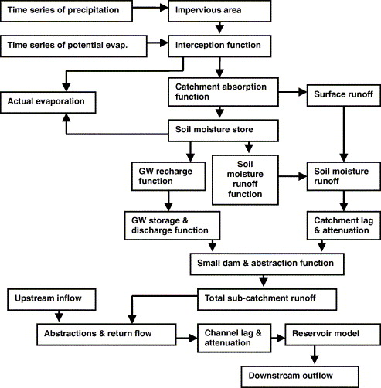
Pitman Hydrological Model
Widely applied within southern Africa region
Explicit soil moisture accounting model representing interception, soil moisture and ground water storages, with model functions to represent the inflows and outflows from these

Slide 14
Pitman versus WEAP
Pitman flexibility:
  Represent total stream flow from different sources using built-in components.
WEAP flexibility:
  ‘Expression builder’ allows for additional flexibility within a relatively simpler model.
  Example is using a moisture storage threshold to limit baseflow outputs and generate zero stream flow in ephemeral rivers.

Slide 15
Some specific differences
Surface runoff generation:
  Pitman based on monthly rainfall total only.
  WEAP based on combination of monthly rainfall total and moisture storage state.
  Makes comparison between parameter sets of the two models more difficult.
Flexibility:
  Pitman model flexibility is built-in through more complexity.
  WEAP model requires experience in the use of the ‘expression builder’ options.
  Ultimately, both require expert knowledge to use effectively.

Slide 16
Overall comparison of the two models
Within the Orange – Senqu system:
  Able to calibrate the WEAP model to reproduce very similar patterns of stream flow as simulated by the Pitman model.
  Most of these achieved with similar water balance components (surface runoff, baseflow, evaporative losses, etc.).
General conclusions:
  Similar uncertainties in the application of the two models.
  Given adequate user experience, the calibration efforts required for the two models are very similar.

Slide 17
Orange-Senqu WEAP calibration for natural conditions.
Learn from Pitman model experience:
  Calibration parameters in different parts of the basin.
  Pitman model results in un-gauged parts of the basin.
  Experience comes from WR90, WR2005, ORASECOM and some IWR studies in the Caledon River sub-basin.
Couple Pitman model outputs with observed stream flow data where available (and not impacted by upstream developments) to evaluate WEAP model.

Slide 18
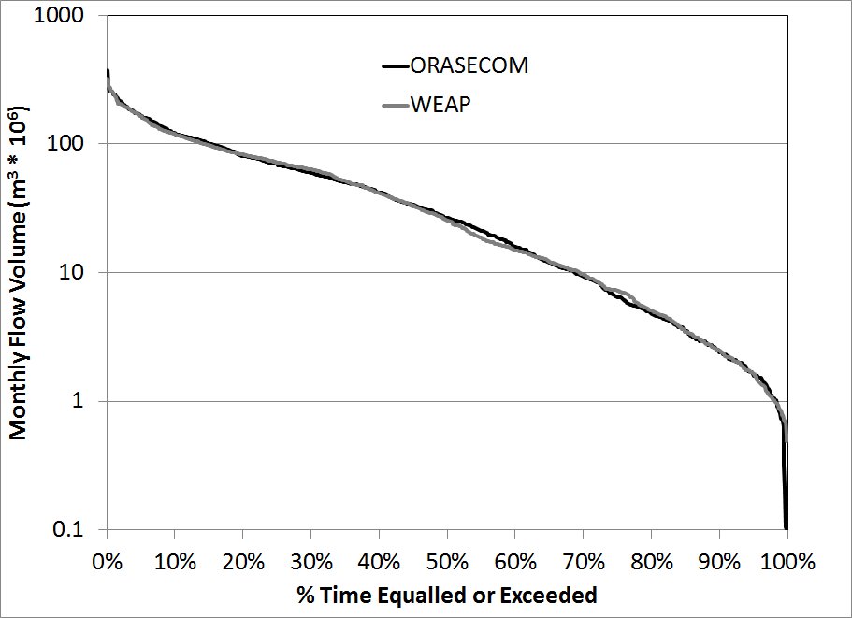
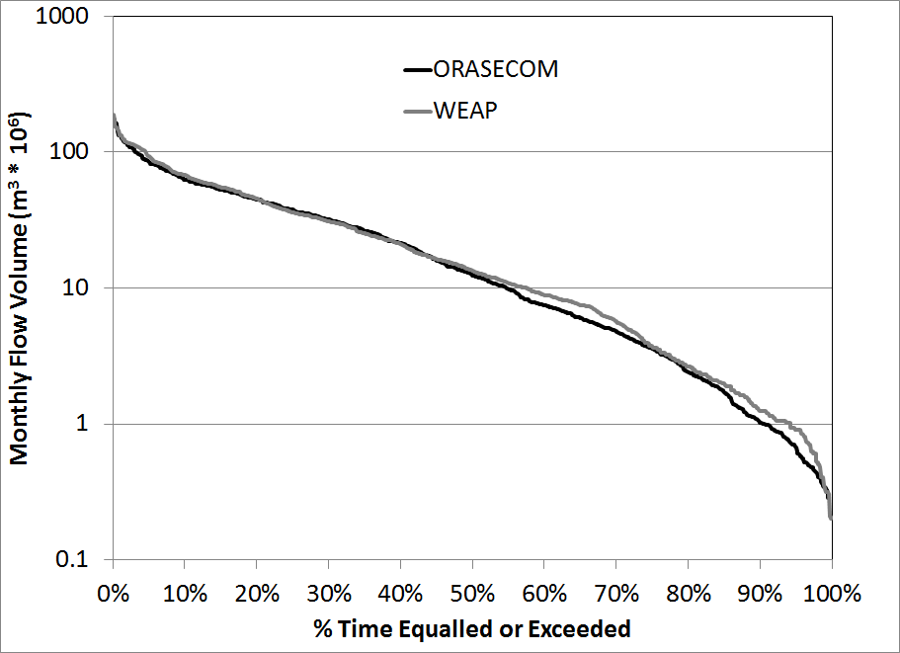
Critical headwater inputs: Katse and Mohale dams
Katse Dam inflows
Mohale Dam inflows
No substantial differences in the frequency distributions of different monthly flow volumes nor in the seasonal distributions of inflow.

Slide 19
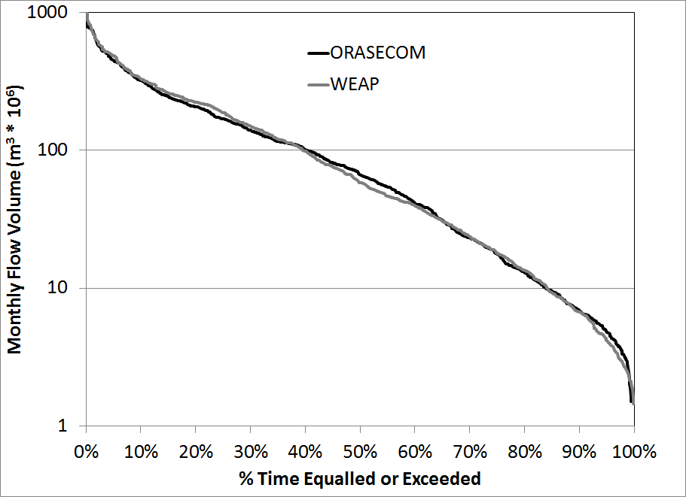
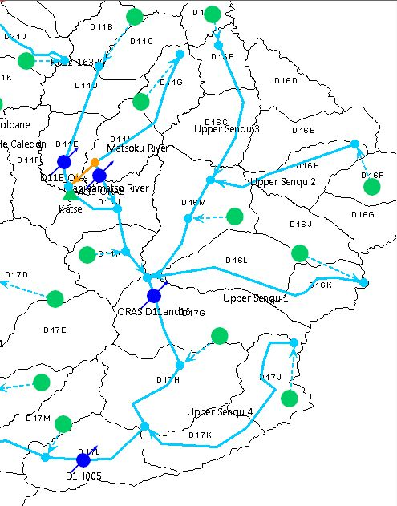
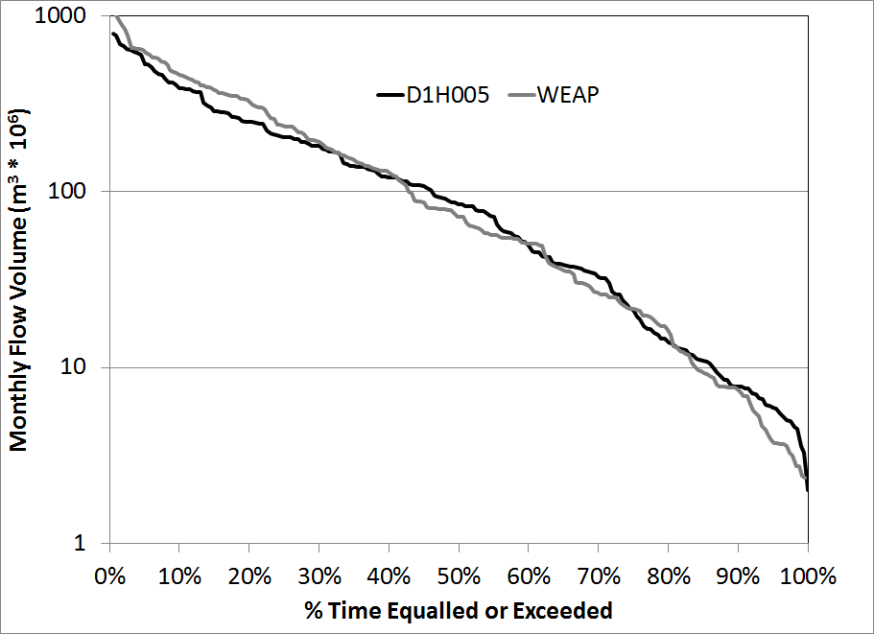
Headwaters of the Senqu
Comparisons with ORASECOM simulations for D11 & D16 (WR2005 quaternary catchments)
for total period of 1920 to 2005.
Comparisons with observed data at D1H005 (for period 1934 to 1945).
Both WEAP simulations are more than adequate simulations compared to accepted information.

Slide 20
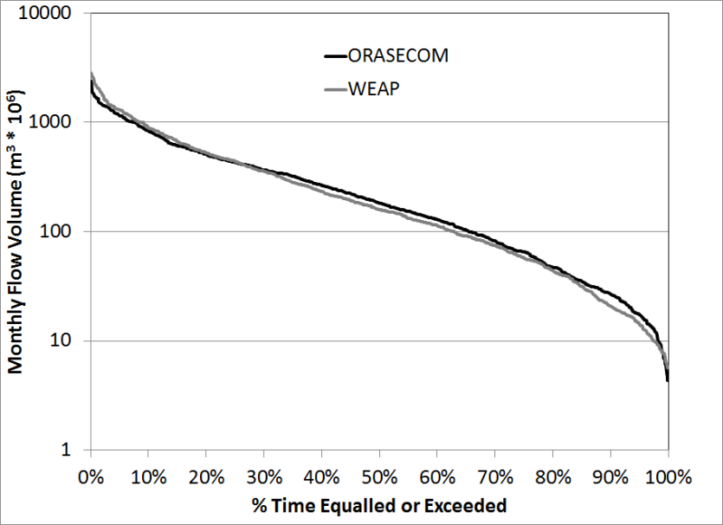
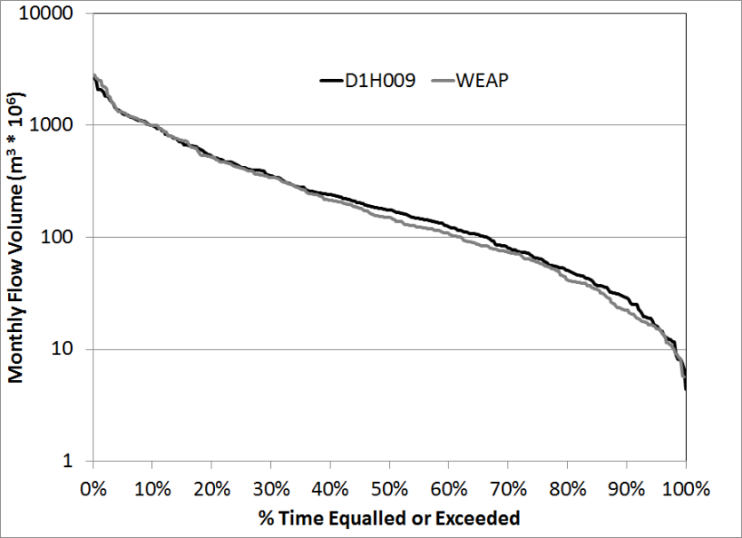
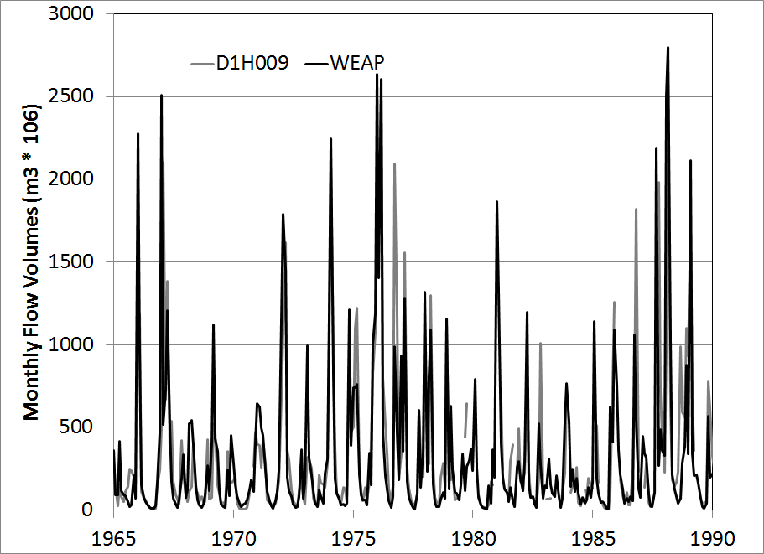
Lesotho/South Africa border
Comparisons with ORASECOM
Comparisons with Observed data at D1H009
Time series of monthly flows (WEAP v Observed) suggest that the model is able to capture most of the critical patterns of wet and dry years.
The ORASECOM comparisons are based on the total simulations period of 1920 to 2005, while the observed data comparisons are based on 1960 to 1992 (avoiding recent development impacts). The results are clearly very favourable.

Slide 21
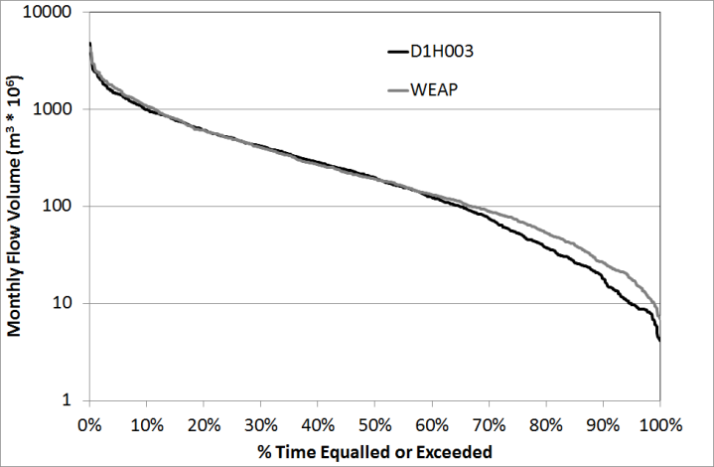
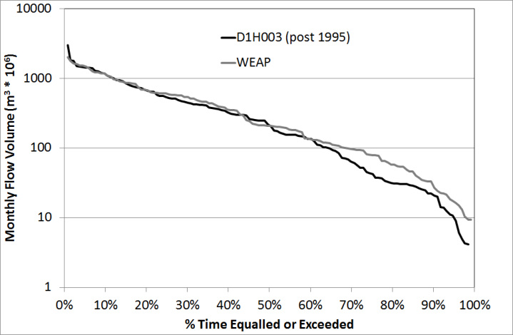
Gauge at D1H003 (Aliwal North - long record)
1920 to 2005
1995 to 2005
These comparisons reflect the increasing uncertainty in agricultural water use that impact on the ability to calibrate any hydrological model for natural flow conditions.

Slide 22
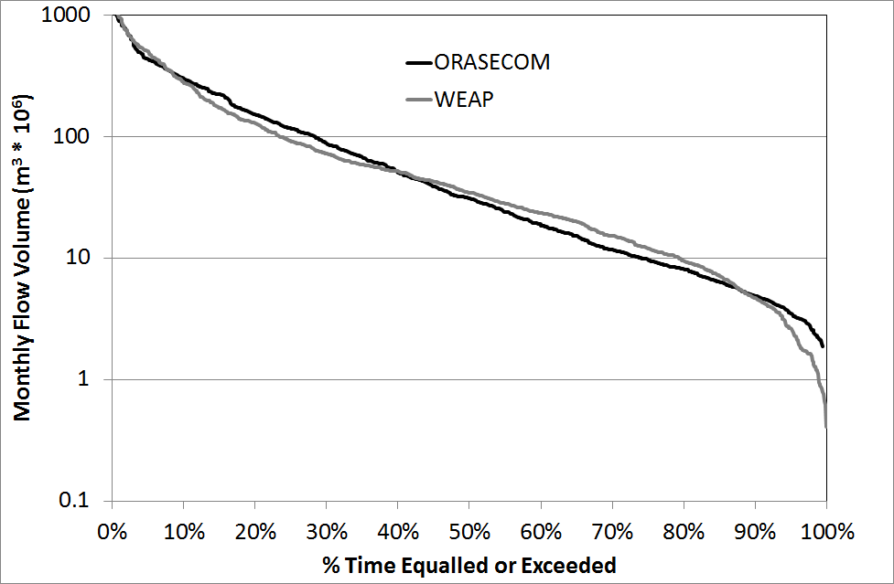
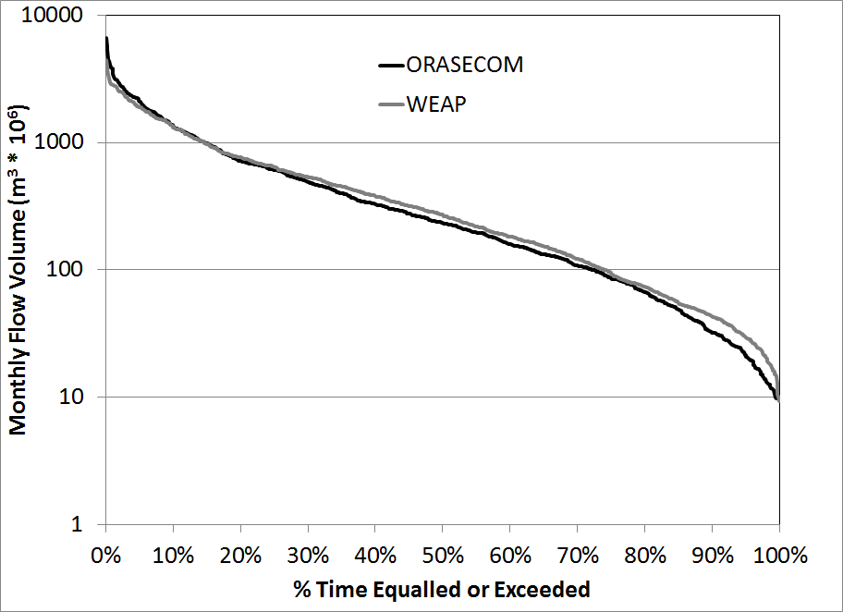
Caledon River inflows
Caledon River
Orange River below confluence with Caledon River
Large uncertainties in the Caledon River, but relatively similar simulations for both WEAP and Pitman (ORASECOM).
Overall impacts on the Orange River at the Caledon confluence are relatively small.

Slide 23
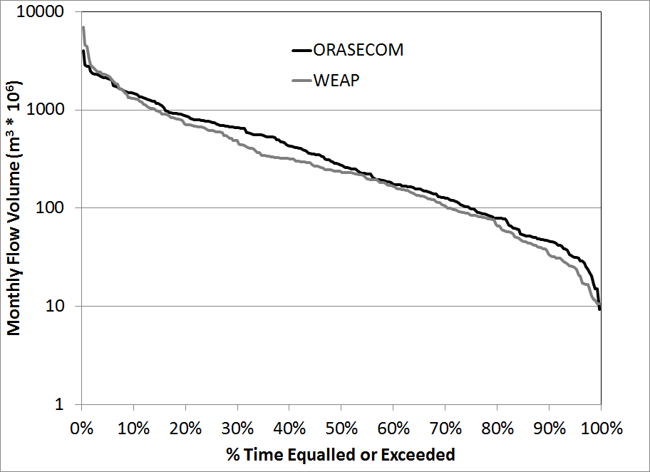
Above the confluence with the Vaal River
Comparisons with ORASECOM and WEAP for 1920 to 1944 (ORASECOM simulations include impacts of Gariep and Van der Kloof Dams and are therefore not natural after 1944).
Despite some over-simulation by WEAP (relative to Pitman) the preliminary results are very encouraging.

Slide 24
Natural simulations - refinements
The project team are confident about most of the simulations.
  Particularly in the Senqu River/Lesotho parts of the basin, when compared with ORASECOM results.
However, there are some areas in the lower parts of the system where refinements are possible:
  Some of these could follow a comparison of simulated developed conditions with recently observed flows.
  Part of the uncertainty is related to the not very well quantified agricultural use in the South African parts of the Orange and Caledon Rivers.

Slide 25
Adding Water Resources Management
Water infrastructure and demands are nested within the underlying hydrological processes.

Slide 26
Subcatchment
Irrigation Scheme
Domestic/Municipal
Reservoir
River Flow
Water Outtake
Flow Requirement
Border
Simplified Schematic of Upper Orange-Senqu River System
Brandwater
Muelspruit
Mopeli
(Pre-Development)
Leeu
Lisoloane
Little Caledon
Tsoaing
Tsanatalana
Senqunyane
Madibamatso
Caledon River
Makhaleng
Matsoku
Upper Orange River
Senqu River
Stormberg
Seekoei
Kraai

Slide 27
Subcatchment
Irrigation Scheme
Domestic/Municipal
Reservoir
River Flow
Water Outtake
Flow Requirement
Border
Simplified Schematic of Upper Orange-Senqu River System
Brandwater
Muelspruit
Mopeli
Leeu
Lisoloane
Muela II
Maseru
Little Caledon
Knellpoort
Muela I
Tsoaing
Bloemfontein
Riet
Transfer
Tsanatalana
Vaal
Transfer
Weldebach
Senqunyane
Madibamatso
Makhaleng
Mohale
Katse
Gariep
Matsoku
Egmont
Van Der
Kloof
Polihali
Hopetown
Stormberg
Seekoei
Kraai
Fish River
Transfer

Slide 28
WRYM and WEAP
 | WRYM | WEAP
Model architecture | Node-link network | Node-link network
Solution method | Simulation of monthly water allocations | Simulation of monthly water allocations
 | Uses linear program (LP) solver with penalty functions that determine ‘cost’ of water delivery and storage decisions. | Uses linear program (LP) solver with demand priorities that determine tiered allocation order of water delivery and storage.
 | Operating policies entered as constraints within the LP | Operating policies entered as constraints (e.g. transfer capacity) or demand (e.g. flow requirement) within the LP
Hydrologic inputs | Streamflow timeseries | Climate timeseries
Demand projections Urban/Domestic | Fixed level of development | Transient growth within bounds of uncertainty
Demand projections Agriculture | Fixed level of development | Climate driven. Subject to transient expansion of area.

Slide 29
WEAP Allocation Logic for Upper Orange-Senqu River System
Water allocation order (highest to lowest)
  Domestic/Municipal Water Users
  Ecological Flow Requirements
  Lesotho Highlands Water Project Operations
  In-basin Irrigation
  Inter-basin Transfers (excluding LHWP)
  Hydropower generation (Gariep and Van Der Kloof)
  Reservoir Storage

Slide 30
Comparison of WEAP to Historical
WEAP operational rules lead to similar reservoir storages

Slide 31
Energy Modeling

Slide 32

An Introduction to OSeMOSYS
  Open Source energy MOdeling SYStem
  At present there exists a useful, but limited set of accessible energy systems models. They often require significant investments in terms of human resources, training and software purchases.
  OSeMOSYS is a fully fledged energy systems linear optimisation model, with no associated upfront financial requirements.
  It extends the availability of energy modelling further to researchers, business analysts and government specialists in developing countries.
  An easily ledgible – 500 line long – open source code written in GNU Mathprog with an existing translation into GAMS.
Leading International Partners

Slide 33
An Introduction to OSeMOSYS
  A Straight forward Building Block based structure
A large user community using and developing different code blocks for OSeMOSYS
Increased tool flexibility with the ability to tailor the code specific modelling requirements
Easy version change management:
OSeMOSYS to be integrated with a Semantic Media Wiki (SMW) being developed by World Bank-ESMAP
Reserve Margin
Salvage Value
Annual Activity
Modular
Structure
Capital
Costs
Total Activity
Operating
Costs
Capacity Adequacy B
Energy Balance B
New Capacity
Discounted Cost
Hydro Facilities
Capacity Adequacy A
Energy Balance A
Total Capacity
(1)
Objective
(2)
Costs
(3)
Storage
(4) Capacity Adequacy
(5) Energy
Balance
(6)
Constraints
(7)
Emissions
Plain English Description
Multiple Levels of Abstraction
Mathematical Analogy
Micro Implementation

Slide 34
An Introduction to OSeMOSYS
  Useful for:
  Medium- to long-term capacity expansion/investment planning
  To inform local, national and multi-regional energy planning
  May cover all or individual energy sectors, including heat, electricity and transport
  Main Assumptions
  Deterministic linear optimisation model - assumes perfect competition on energy markets.
  Driven by exogenously defined demands for energy services.
  These can be met through a range of technologies.
  Technologies consume resources, defined by their potentials and costs.
  Policy scenarios impose certain technical constraints, economic implications or environmental targets.
  Temporal resolution: consecutive years, split up into ‘time slices’ with specific demand or supply characteristics, e.g., weekend evenings in summer.

Slide 35
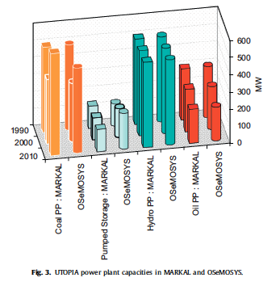
An Introduction to OSeMOSYS
  A tested ability to Replicate Results
Tested on standard model cases against established MARKAL modelling frameworks
Derived from standard demonstration application used in MARKAL
Region description:
  Lighting/Heating/Transport demands
  Multiple generation options
  Multiple Fuels
  Multiple time slices over for seasonal demand fluctuation
Comparable results between both modelling structures

Slide 36
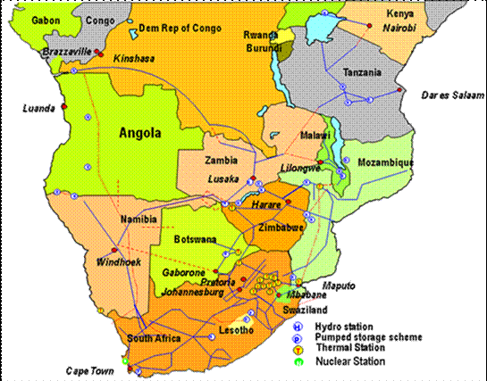
The Southern African Power Pool Model
Based on latest SAPP consultations
Hundreds of investment options
Invests in optimal mix of fossil, hydro, other RE, nuclear and trade to meet growth

Slide 37
The link to the water modeling
Inputs
Outputs – e.g.
Technology Description Parameters
Infrastructure description parameters
Constraints (e.g. resources / emissions etc.)
Demands per sector
Energy Model
Detailed optimal cost solution
Detailed investment plan / capacity plan
Energy mix and detailed energy flow
Comprehensive constraints measurement
C1
C2
C3
C4
Energy for water processing
Energy for water pumping
Water available for hydropower
Water for power plant cooling
Water Model

Slide 38
Model Design Features
Common grounds with previous work
Latest available Power Pool modelling | Current World Bank effort
Electricity demand divided in 3 categories - heavy industry, urban and rural. Transmission and distribution losses vary for each category.
Off-grid power generation examined closely.
More than 25 power generating options for each country.
Detailed assessment of existing, planned and potential power plants.
Detailed assessment of both Fossil and Renewable Resource potentials

Slide 39
Model Design Features
Some noteworthy improvements
Latest available Power Pool modelling | Current World Bank effort
Year split in 3 seasons with 3-4 day parts for each season. | Year split in 12 months with 4 day parts for each month; greater detail
Existing hydroelectric plants aggregated together for each country. | Existing and potential hydroelectric plants modelled individually; increased flexibility
Model horizon to 2030 with two ten-year steps to 2050 | Year based study with modelling horizon to 2070

Slide 40
Analysis of Hydropower generation

Slide 41
Indicative Results – Reproducing Previous Modelling Efforts
PP modeling

Slide 42
Mozambique Hydro Generation

Slide 43
Namibia Hydro generation

Slide 44
Zambia Hydro Generation

Slide 45
Zimbabwe Hydro Generation

Slide 46
South Africa Generation Mix

Slide 47
Introducing Climate Projections

Slide 48
These Model are Sensitive to Assumptions about Future Climate

Slide 49
Climate Impact on Hydropower Generation
Degree of wetness/dryness of future climate will influence hydropower production

Slide 50
Climate Impact on Irrigation Requirements
Irrigation requirements are higher as less water is naturally available within the soil

Slide 53
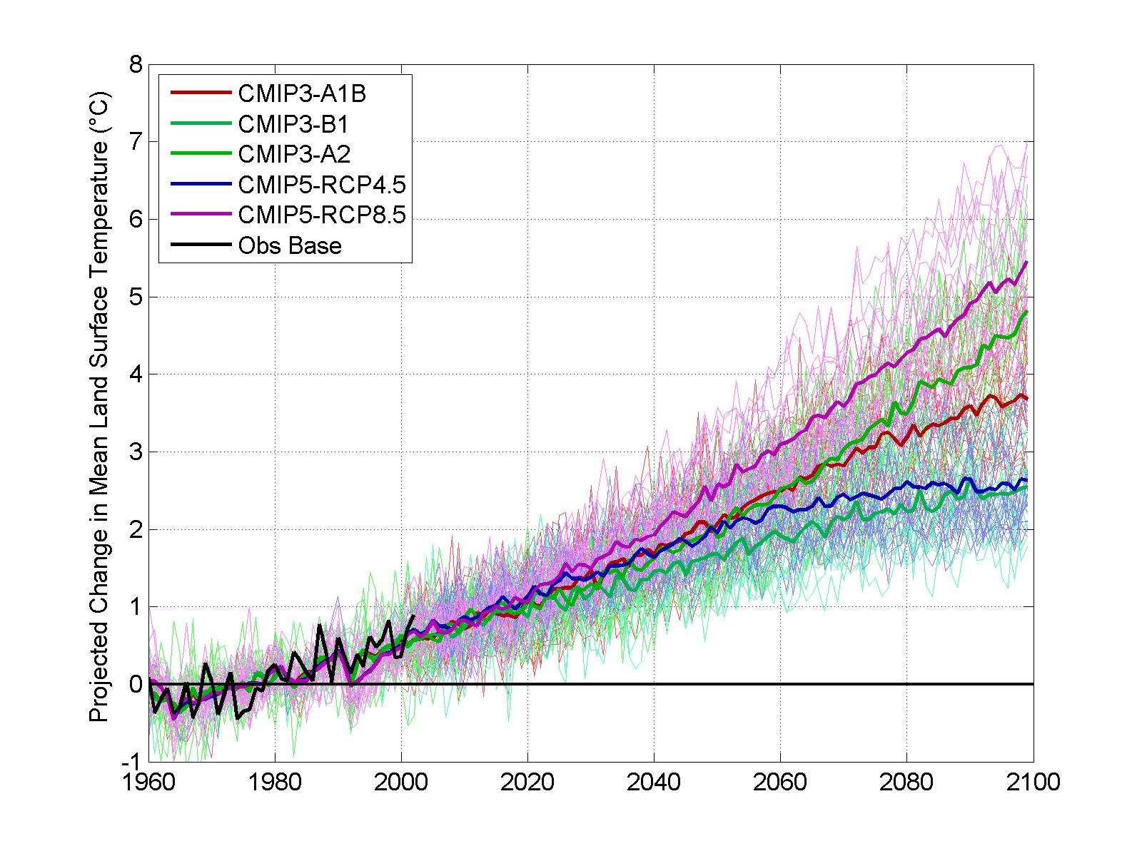
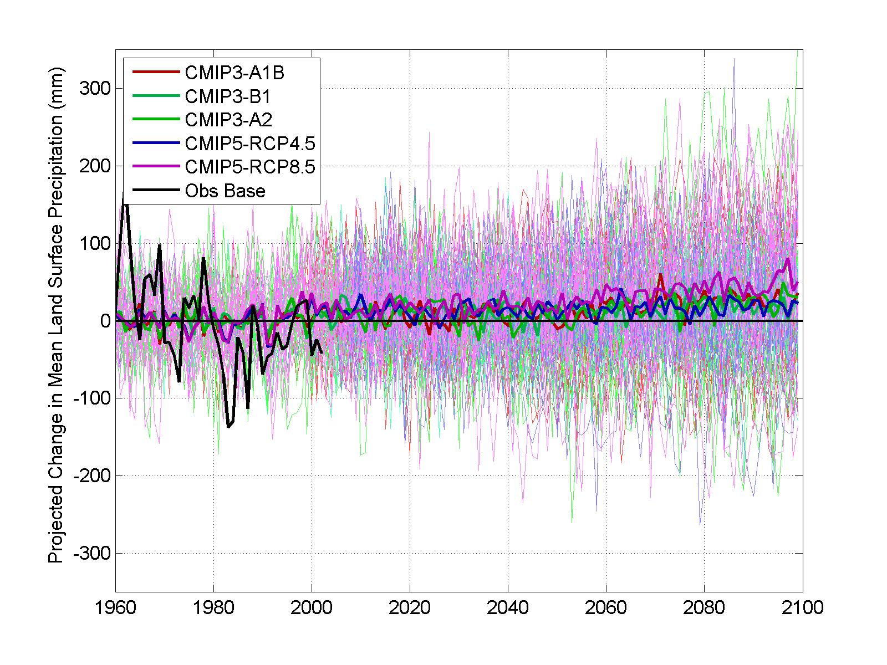
We can use our models to explore a range of potential future climate conditions.

Slide 54
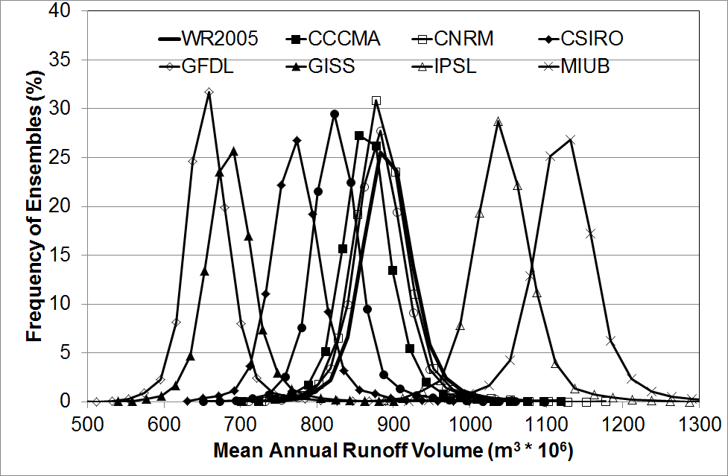
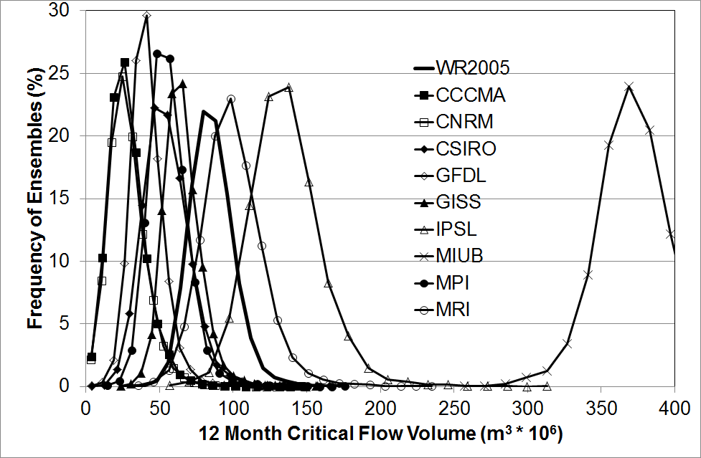
Previous study of Caledon River using Pitman model indicates a range of possible changes in runoff and critical yield

Slide 55
Robustness Analysis
Uncertainties:
Changes in Climate
Changes in Population
Changes in Landuse
Response Strategies:
Add infrastructure (e.g. desalination)
Improvements in system efficiency
Wastewater reuse
Demand Management
OSeMOSYS
Outcome Metrics:
Delivery reliability
Unmet demands
Hydropower generation
Groundwater & surface water storage
Notes:
Iterative, analytic process designed to identify strategies that are robust to a wide range of planning uncertainties.

